Slide 1



CONSUMER GOODS AD-HOC INSIGHTS (Using SQL)
Codebasics Resume Challenge 4
Created & Presented By:
Dhrubajyoti Das

Slide 2


Problem statement
Atliq Hardwares is one of the leading computer hardware producers in India andit had also expanded well in other countries too.
However, the management noticed that they do not get enough insights to make quick and smart data-informed decisions. They want to know how their business is performing, the drawbacks in the business and scopes of improvement and expansion by getting answers to 10 questions from their business data.

Slide 3
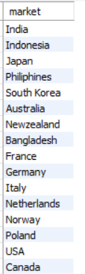
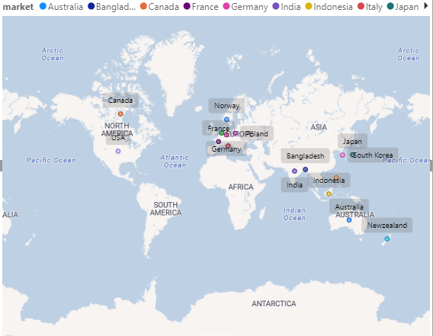
Q1. Provide the list of markets in which customer "atliq exclusive" operates its business in the APAC region.
RESULT:
SQL QUERY:

Slide 4
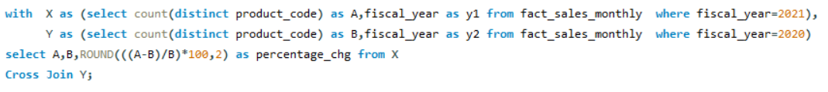


Q2. What is the percentage of unique product increase in 2021 vs. 2020? The final output contains these fields-1)unique_products_2020 2)unique_products_20213)percentage_chg
SQL QUERY:
Insights:
A-2021
B-2020
KEY TAKEAWAY: Unique products increased from 245 in 2020 to 334 in 2021 by 36%

Slide 5

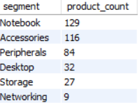
Q3. Provide a report with all the unique product counts for each segment and sort them in descending order of product counts. The final output contains 2 fields-1)segment2)product_count
SQL QUERY:
Insights:
KEY TAKEAWAY: Maximum products are from notebook segment followed by accessories. The least number of products are from networking segment

Slide 6
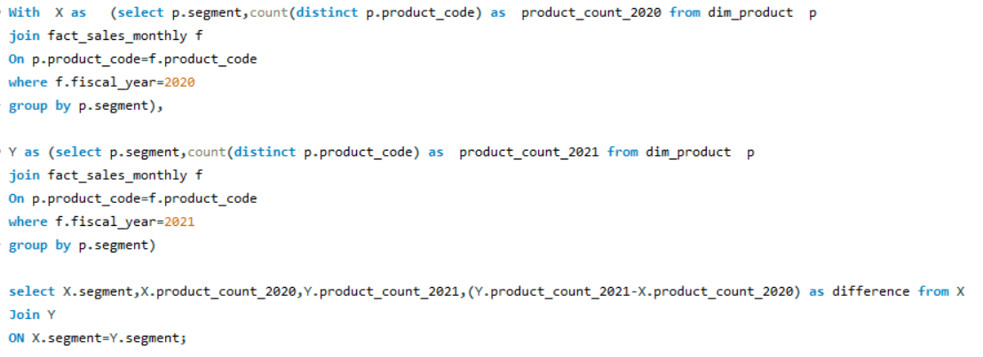
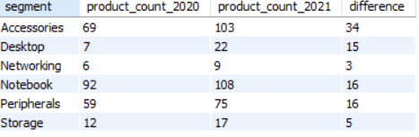
Q4. Follow-up: Which segment had the most increase in unique products in 2021 vs 2020? The final output contains these fields:- segment, product_count_2020,product_count_2021,difference
SQL QUERY:
Insights:

Slide 7
KEY TAKEAWAY: The number of products in accessories increased the most from 2020 to 2021 followed by notebook and peripherials.

Slide 8
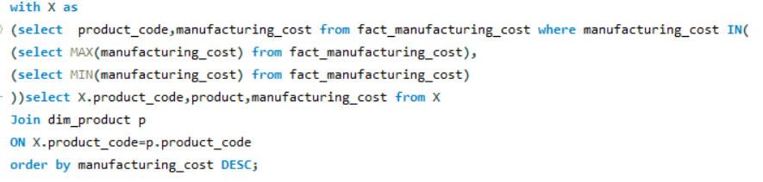

Q5. Get the products that have the highest and lowest manufacturing costs. The final output should contain these fields:- product_code, product, manufacturing_cost
SQL QUERY:
Insights:
KEY TAKEAWAY: Highest manufacturing cost is for AQ HOME Alin 1 Gen 2 and lowest manufacturing cost is for AQ Master wired x1 Ms

Slide 9
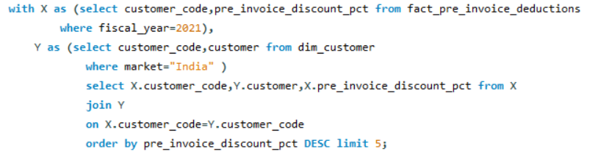
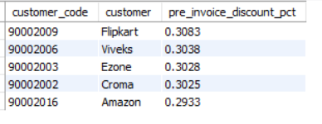
Q6.Generate a report which contains the top 5 customers who received an average high pre_invoice_discount_pct for the fiscal year 2021 and in the Indian market. The final output contains these fields:- 1)customer_code 2) customer 3)fact_pre_invoice_deductions 4)average_discount_percentage
SQL QUERY:
Insights:
KEY TAKEAWAY: Flipkart is getting the highest pre-invoice discounts followed by Viveks,Ezone,Croma,Amazon.

Slide 10
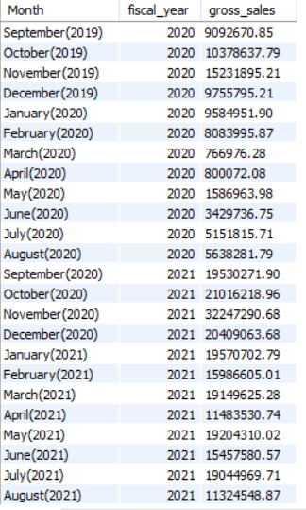
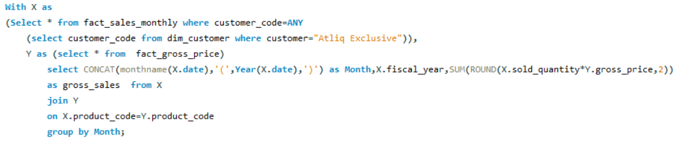
Q7. Get the complete report of the Gross sales amount for the customer “Atliq Exclusive” for each month. This analysis helps to get an idea of low and high-performing months and take strategic decisions. The final report contains these columns:-1) Month 2) Year 3)Gross sales Amount
SQL QUERY:
Insights:

Slide 11
KEY TAKEAWAY: Good volume of sales occurs in the months of September ,October,November,December and January with the max sales on November.Lowest sales occurs in the month’s of March ,April,May and June with the lowest in April.

Slide 12
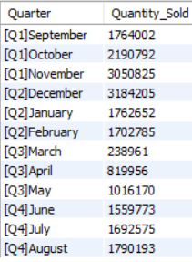
Q8. In which quarter of 2020, got the maximum total_sold_quantity? The final output contains these fields sorted by the total_sold_quantity:-1)Quarter2)total_sold_quantity
SQL QUERY:
Insights:
KEY TAKEAWAY: Lowest sales occurs in Q3 of the year.

Slide 13
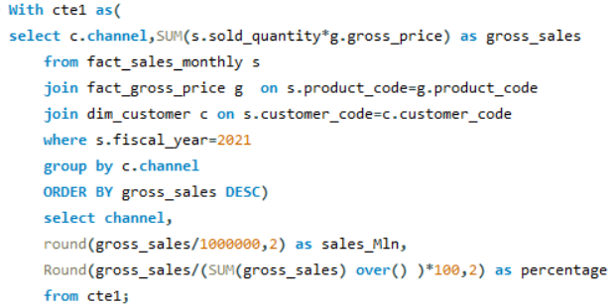

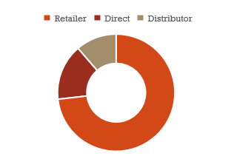
Q9. Which channel helped to bring more gross sales in the fiscal year 2021 and the percentage of contribution? The final output contains these fields:-1) channel 2) gross_sales_mln3) percentage
SQL QUERY:
Insights:
KEY TAKEAWAY: Retail is the most popular channel of sales.

Slide 14
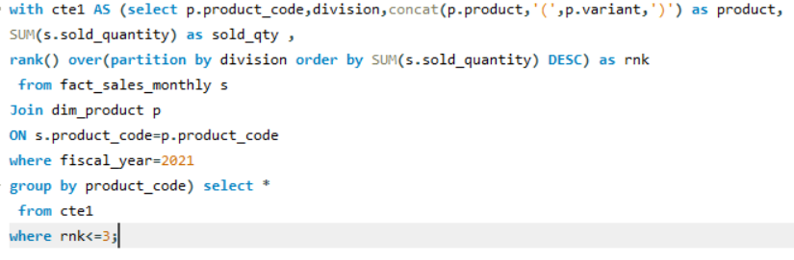
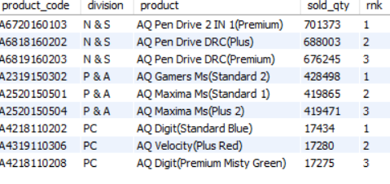
Q10. Get the top 3 products in each division that have a high total_sold_quantity in the fiscal_year 2021? The final output contains these fields :-1)division2)product_code3)product4)total_sold_quantity5)rank_order
SQL QUERY:
KEY TAKEAWAY: N&S is the most performing division.
Insights:

Slide 15

Thank You
THANK YOU
Special thanks to Dhaval Sir, Hemanand Sir and entire codebasics team for providing the opportunity to do this project

